Slide 2
Practical physiology
Lab 2
Hematocrit

Slide 3
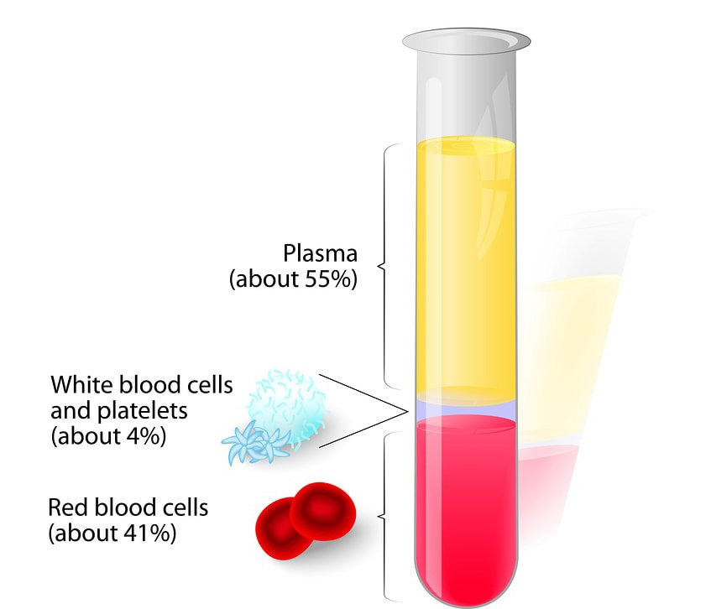

Slide 4
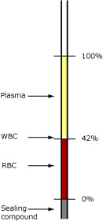

Slide 5
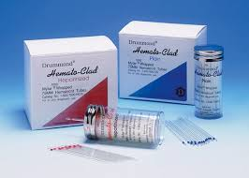

Slide 6
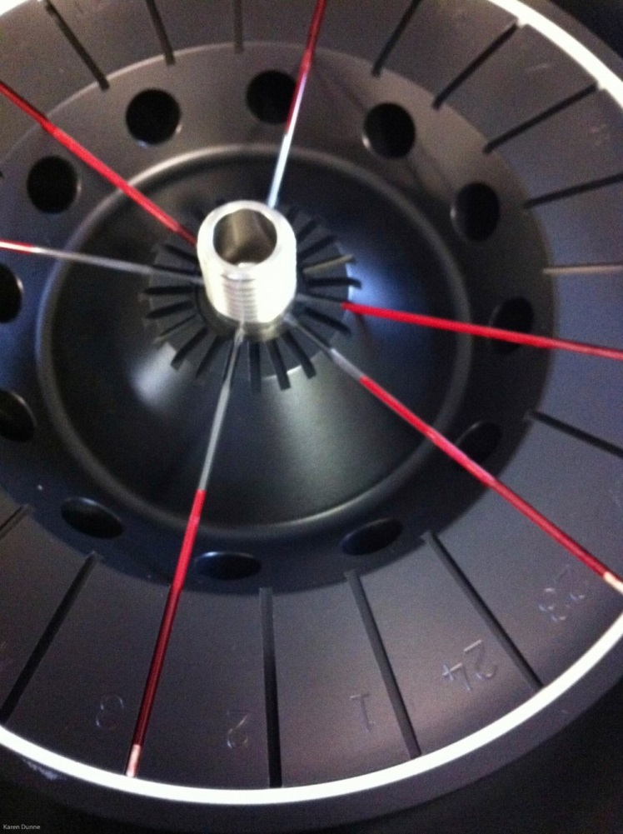
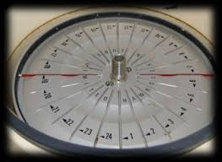

Slide 7
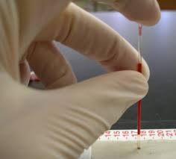
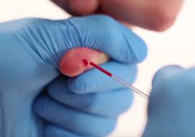

Slide 9
 | Male | Female
Packed Cell Volume (PCV)/Haematocrit (HCT) % | 0.40-0.524 45 | 0.37-0.47 40

Slide 10
Low hematocrit may be due to:
Anemia
Bleeding
Destruction of red blood cells
Malnutrition
Nutritional deficiencies of iron, folate, vitamin B12, and vitamin B6
Overhydration

Slide 11
High hematocrit may be due to
Congenital heart disease
Dehydration
Cor pulmonale
Erythrocytosis
Low blood oxygen levels (hypoxia
Pulmonary fibrosis
Polycythemia vera

